Slide 1

Multi Camera Tracking Project
Spring 2025 – Bi weekly progress, 30 April, 2025

Slide 2
Agenda
Objective
Recap
Progress Overview
Qualitative analysis of Trace-1573
Observation on CLIP-ReID predictions
Arcface loss as Classification loss
Analysis of Train data and data augmentations
Conclusion
Next steps

Slide 3
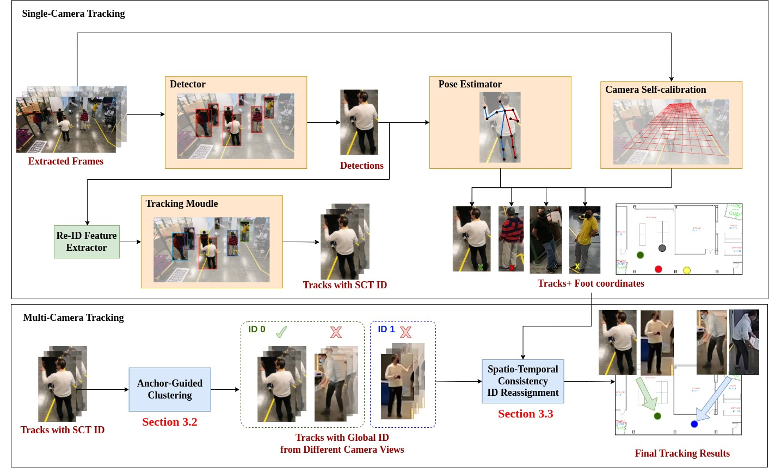
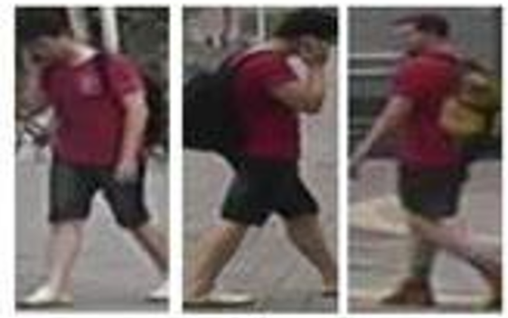
Objective
Develop a robust multi-camera tracking model with a focus on person re-identification (Re-ID).
Focus
Re-ID Module

Slide 4
Recap
Extensive data analysis on Trace-1573 multi camera dataset.
Trace-1573 ReID Dataset Curation.
Conducted initial experiments with CLIP-ReID and OSNET using Trace-1573.
Evaluated Trace-1573 dataset with combined training data Market-1501 using various sampling strategies.
Ablation study on Cosine vs Euclidean ; Triplet Loss vs Arc Face Loss
Explored synthetic caption generation and 3d human reconstruction model LHM

Slide 5
Trace-1573 ReId data , metrics
This dataset consists of 834 person identities.
All persons does not appear across all the cameras.
mAP(Mean Average Precision )
Evaluates how well correct matches are ranked across the gallery
Considers all correct matches – not just the first match for a query
Top-1 Accuracy
Checks if the top-ranked match is the correct identity
Focuses on precision at the highest rank - just the first retrieved result.
​​
​
Split | IDs | Images | Cameras
Train | 414 | 12720 | 45
Query | 420 | 4099 | 43
Gallery | 390 | 14976 | 43
Test set
Person 10 images in train and 15 in test (12 gallery , 3 query)
Notes:
594 previous IDS

Slide 6
Experimental Results
Method | Train data | Test data | MAP(%) | Top-1 Accuracy(%)
OSNeT | Market-1501 | Market-1501 | 78.3 | 93.8
CLIP-ReID | Market-1501 | Market-1501 | 89.8 (14.6 % ) | 95.3(1.6 % )
OSNET | Trace-1573 ReID | Trace-1573 ReID | 35.7 | 69.2
CLIP-ReID | Trace-1573 ReID | Trace-1573 ReID | 63.3 (77.3 % ) | 80.8 (16.7 % )
OSNET | Market-1501 | Trace-1573 ReID | 7.5 | 25.4
CLIP-ReID | Market-1501 | Trace-1573 ReID | 40.1 (434 % ) | 61.7(36.3 % )
Show Strong generalization
Results of CLIP-ReID , OSNET in same dataset setting(Top 4 rows ) and cross dataset(bottom 2 rows) setting evaluations using Market-1501 , Trace-1573 ReID datasets

Slide 7
ReID Triplet Loss : Cosine vs Euclidean distance
Training Objective : Triplet hard mining loss
During Inference , Euclidean distance is used to compute distance matrix.
Method | Metric | Train data | Test data | MAP(%) | Top-1 Accuracy(%)
CLIP-ReID | Euclidean | Market-1501 | Market-1501 | 89.8 | 95.3
CLIP-ReID | Cosine | Market-1501 | Market-1501 | 86.8 | 93.9
CLIP-ReID | Euclidean | Trace-1573 | Trace-1573 | 63.8 | 80.0
CLIP-ReID | Cosine | Trace-1573 | Trace-1573 | 57.9 | 77.2
Euclidean distance provides better clustering of person IDs compared to cosine distance.
Notes:
Euclidean distance forms clusters based on absolute positioning, making it more effective when featurerepresentations are well-distributed.
Cosine distance may place different identities closer together if they share similar directional features buthave different magnitudes, leading to less distinct clustering.

Slide 8
Experimental Results: Trace 1573 ReID Data
No of Samples per person ID per Camera | Method | MAP(%) | Top-1 Accuracy(%)
Train Set : 10 Gallery Set : 12 Query Set : 3 | OSNET | 34.2 | 68.4
 | CLIP-ReID | 63.3 | 80.8
Train Set : 30 Gallery Set : 12 Query Set : 3 | OSNET | 36.4 | 68.5
 | CLIP-ReID | 59.7 | 79.2
Train Set : 5 –min 50 max Gallery Set : 12 Query Set : 3 | OSNET | 36.1 | 67.2
 | CLIP-ReID | 56.5 | 77.2
Observation :
Traditional CNNs: Performance improves as training data increases.
Foundational models Perform well with few samples, but too much data may reduce to generalize.

Slide 9
Experimental Results: Market+Trace 1573 ReID Data
Method | Sampling | Train set | Test set | MAP(%) | Top-1 Accuracy(%)
OSNET | Random Identity Sampling | Trace-1573 | Trace-1573 | 35.7 | 69.2
OSNET |  | Market-1501+ Trace-1573 | Trace-1573 | 36.5 | 67.6
CLIP-REID |  | Trace-1573 | Trace-1573 | 63.5 | 78.6
CLIP-REID |  | Market-1501+ Trace-1573 | Trace-1573 | 66 | 81.7
Method | Sampling | Train data | Test data | MAP(%) | Top-1 Accuracy(%)
OSNET | Random Dataset Sampling | Trace-1573 | Trace-1573 | 35.7 | 69.2
OSNET |  | Market-1501+ Trace-1573 | Trace-1573 | 33.5 | 65.4
CLIP-ReID |  | Trace-1573 | Trace-1573 | 63.5 | 78.6
CLIP-ReID |  | Market-1501+ Trace-1573 | Trace-1573 | 61.5 | 79.8

Slide 10
Arc Face vs Triplet Hard Mining Loss
Experimental study on different loss functions with CLIP-ReID method.
Data | Loss Function | MAP(%) | Top-1 Accuracy(%)
Market-1501 | ArcFace | 86.1 | 94.4
 | Triplet | 89.8 | 95.3
Trace-1573 | ArcFace | 54.2 | 77.1
 | Triplet | 63.3 | 80.8
Data | ArcFace Margin M in degree | MAP(%) | Top-1 Accuracy(%)
Trace -1573 | 15 | 56.1 | 77.7
 | 28.2 (default) | 54.2 | 77.1
 | 40 | 52.5 | 74.6
Triplet loss is better able to generalize across embedding space where as ArcFace is more sensitive to class imbalance.

Slide 11
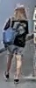
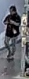
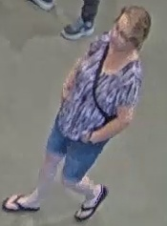
Examples : Generated synthetic captions from LLaVA
Prompt : “Describe the most obvious one people using this template for no more than 45 words: A [age] [gender] is wearing [upper clothes]. [gender] is wearing [upper clothes] and [lower clothes]. The [gender] is wearing [shoes] and carrying a [others]. The [gender] has [hair length] [and whether wear glasses].”
A young woman is wearing a black shirt and shorts. She is carrying a backpack and has long blonde hair.
A man is wearing a black shirt and pants.
A woman is wearing a purple shirt and shorts. She is wearing a watch and carrying a purse. The woman has short hair and is wearing glasses.
Temperature : 0.2

Slide 12
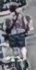


Examples : Generated synthetic captions from LLaVA
A man is wearing camouflage shorts and a watch
A man is wearing a white shirt and khaki shorts. He is wearing a watch and carrying a cane. The man has short hair and is wearing glasses.
A young man is wearing a black shirt and shorts. He is carrying a backpack and has short hair.

Slide 13
Experimental Results : Varying Samples per person ID
No of Samples per person ID per Camera | Method | Train data | Test data | MAP(%) | Top-1 Accuracy(%)
Train Set : 10 Gallery Set : 12 Query Set : 3 | OSNET | Trace-1573 ReID | Trace-1573 ReID | 34.2 | 68.4
 | CLIP-ReID | Trace-1573 ReID | Trace-1573 ReID | 63.3 | 80.8
Train Set : 30 Gallery Set : 30 Query Set : 5 | OSNET | Trace-1573 ReID | Trace-1573 ReID | 41.2 | 80.3
 | CLIP-ReID | Trace-1573 ReID | Trace-1573 ReID | 62.5 | 83.0

Slide 14
Progress
CLIP-ReID experiments with ArcFace loss along with Triplet loss
Conducted Qualitative Analysis on CLIP-ReID evaluation
Observations on Modified Query and Gallery sets
Visualization of feature distances between Query and Top-5 Gallery matches
Analyse the training data samples of Trace-1573
Apply data augmentations while training

Slide 15
Arc Face and Triplet Hard Mining Loss
Experiments with CLIP-ReID
Objective function :
ID_loss + Triplet_loss
ArcFace distance metric : Cosine
Dataset | ArcFace margin m | MAP(%) | Top-1 Accuracy(%)
Trace -1573 | 0.3 | 57.0 | 78.0
 | 0.5 | 56.3 | 77.9
 | 0.7 | 55.7 | 77.7
 | - | 63.3 | 80.8
Classification ID loss is ArcFace
ID loss is Cross Entropy

Slide 16
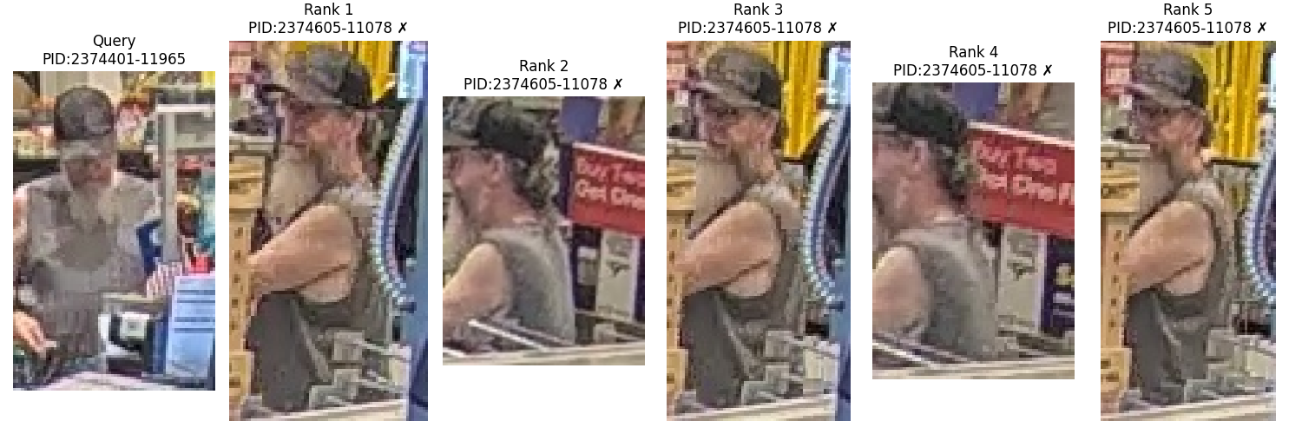
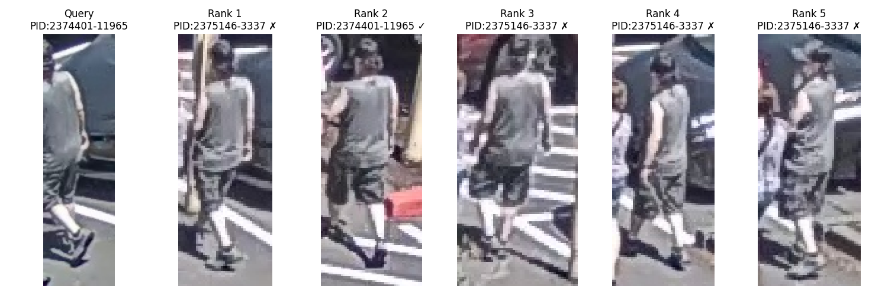
Qualitative Evaluation on Trace-1573 : Negative cases
Inconsistent person Id
Labeling
Low DPI

Slide 17
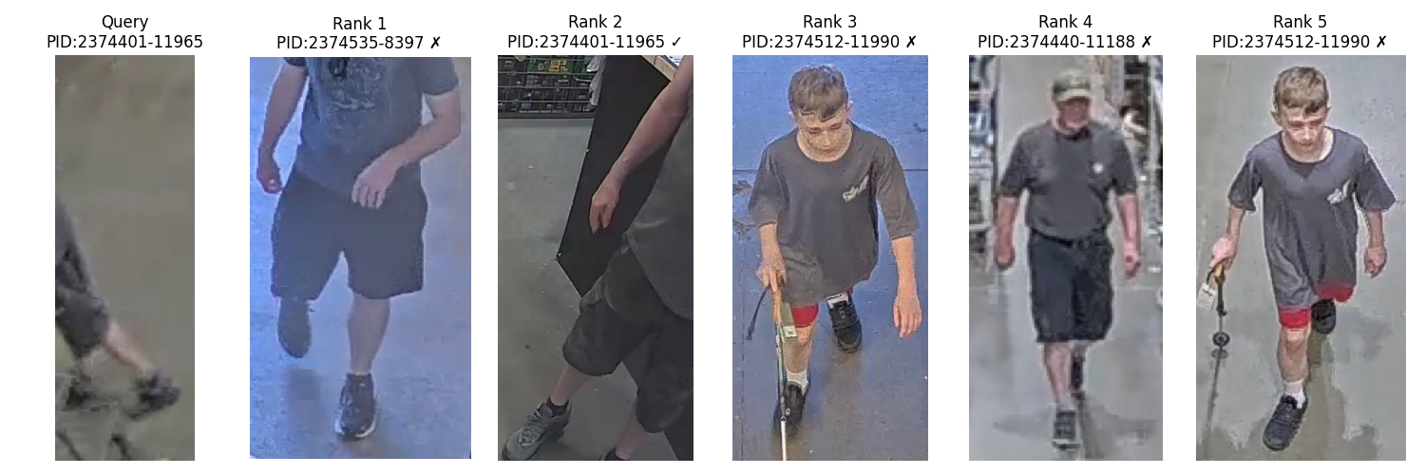
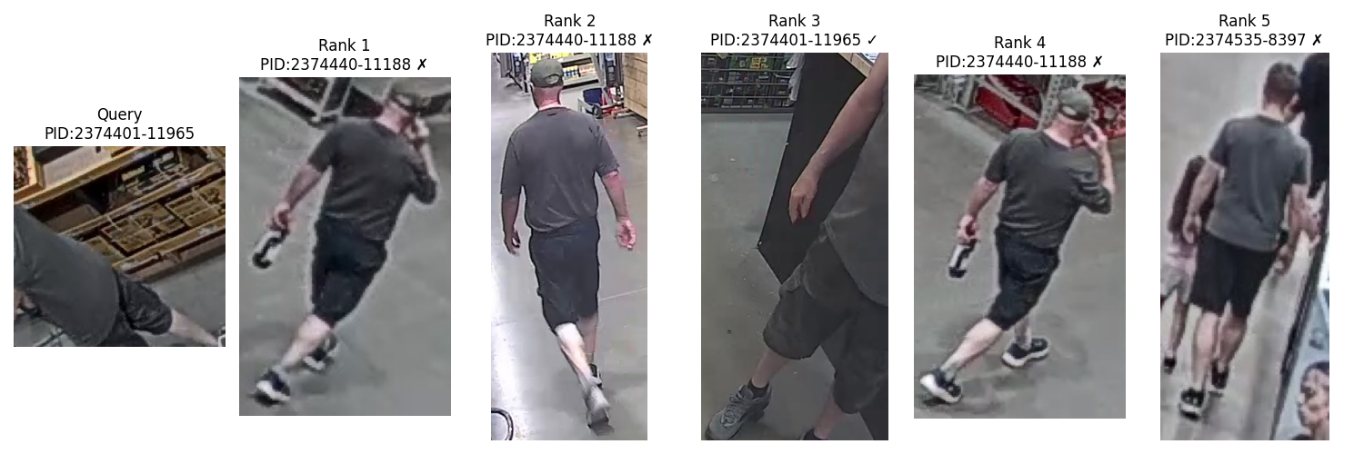
Qualitative Evaluation on Trace-1573 : Negative Cases
Query image has missing body parts

Slide 18
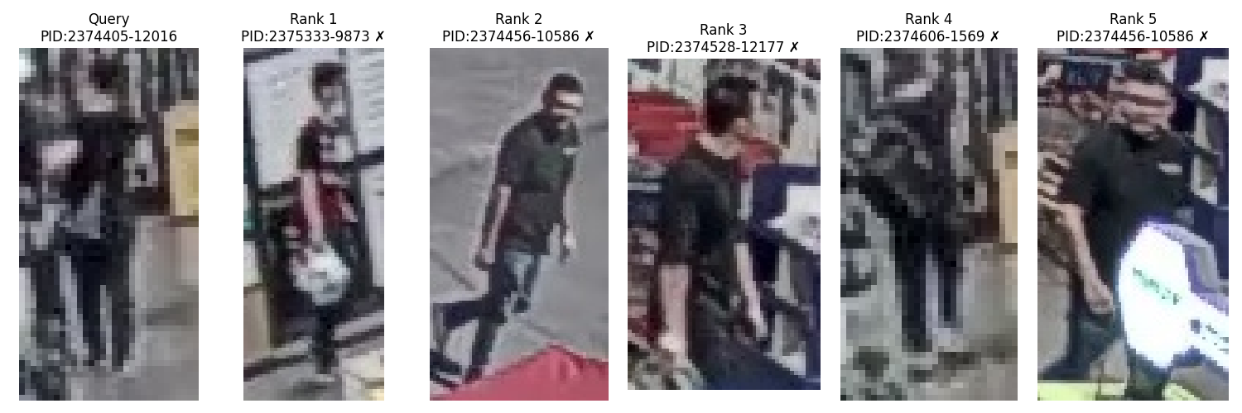
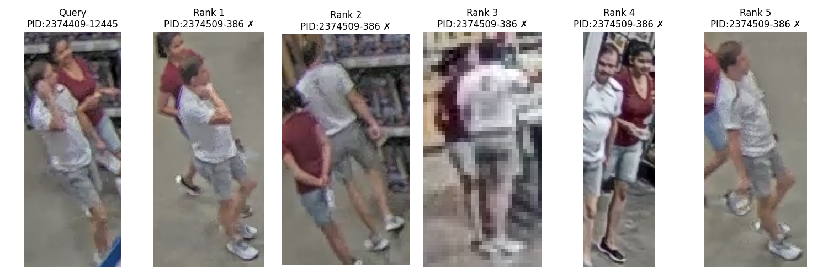
Qualitative Evaluation on Trace-1573
Distant detections
causes
Low DPI / poor resolution of ReID Data
Multiple persons detected in single frame
Person occlusions

Slide 19
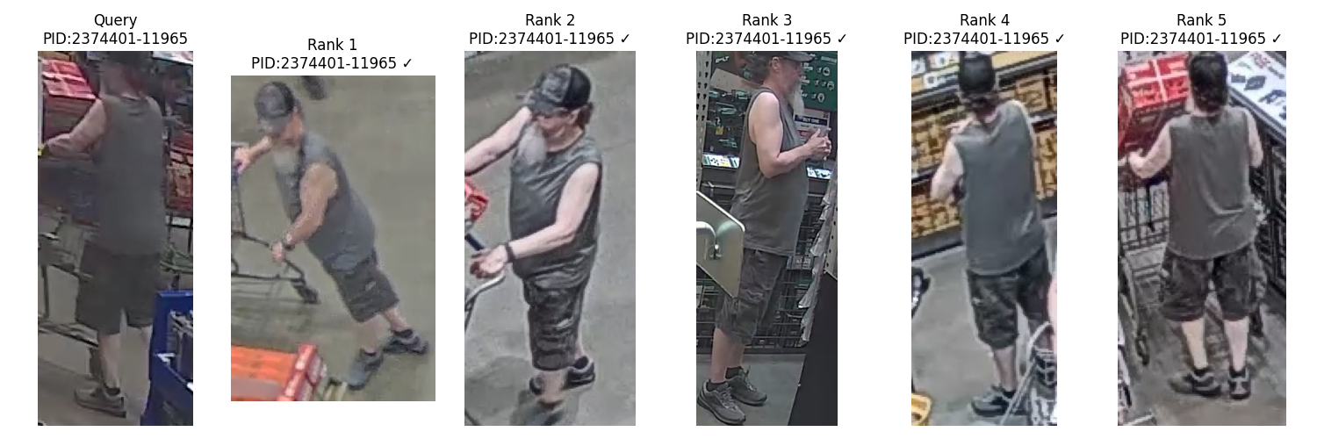

Qualitative Evaluation on Trace-1573 : Positive cases
Re-ID working with different views and even in occlusions

Slide 20
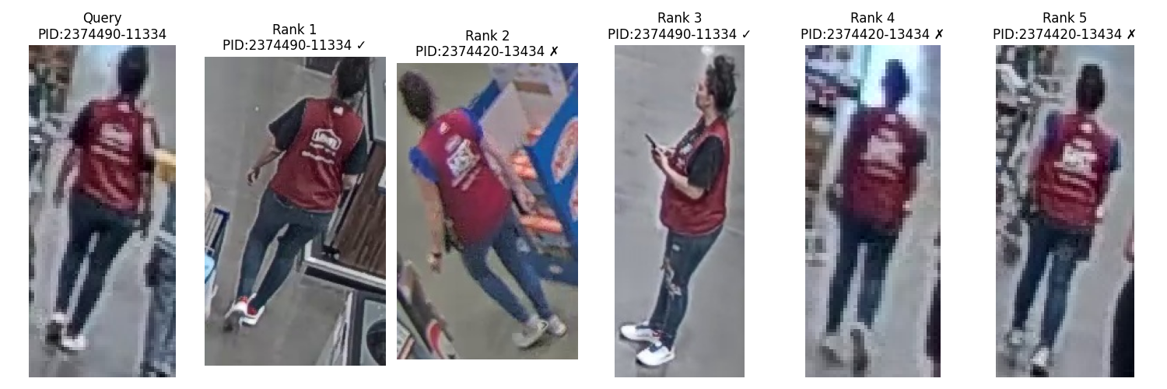
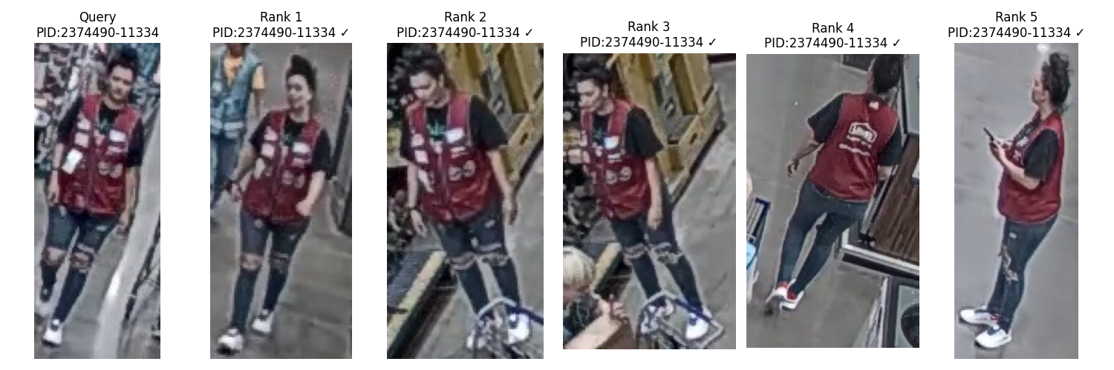
Qualitative Evaluation on Trace-1573 : Positive cases
Re-ID working with different views

Slide 21
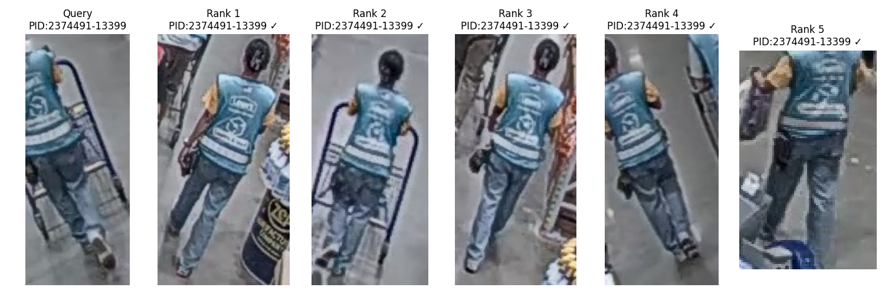
Trace Reid data filtering using pose estimation
>8 joints
Consider
Yolo-v8 Pose estimator
Multi person frames
joints <8 Discard
Confidence each keypoint : 0.5
Is issue of re-ID performance drop coming when we have a lot of occlusions or only a few body parts visible?

Slide 22
Performance Comparison After Filtering
Split | IDs | Images | Cameras
Train | 414 | 12720 | 45
Query | 420 | 4099 | 43
Gallery | 390 | 14976 | 43
Min_keypoints | Query set | Gallery set | mAP | Top-1
8 | 1856 | 9152 | 78.0 | 90.4
9 | 1743 | 8873 | 78.5 | 90.1
10 | 1608 | 8409 | 79.3 | 90.1
11 | 1484 | 7938 | 81.3 | 91.9
12 | 1302 | 7179 | 82.0 | 91.2
Initial data split of Trace-1573
Method | mAP | Top-1
CLIP-ReID | 63.3 | 80.8
More body parts visible more re-ID performance

Slide 23
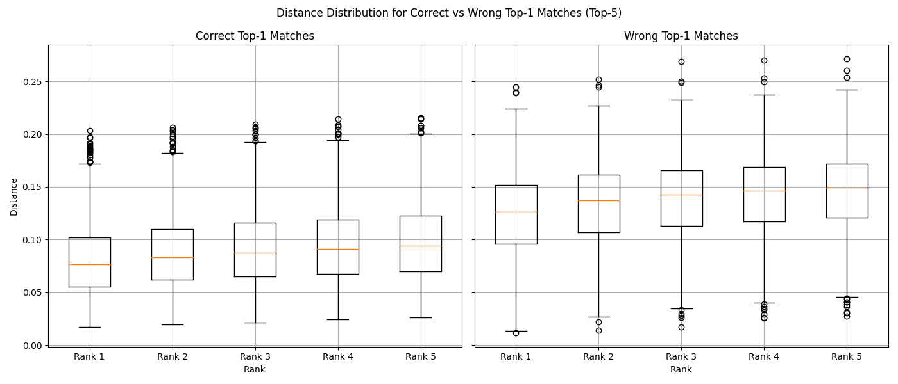
Analysis of Distance matrix
Correct Top-1 Matches:
Rank 1: Mean = 0.0811, Std = 0.0331
Wrong Top-1 Matches:
Rank 1: Mean = 0.1230, Std = 0.0387

Slide 24
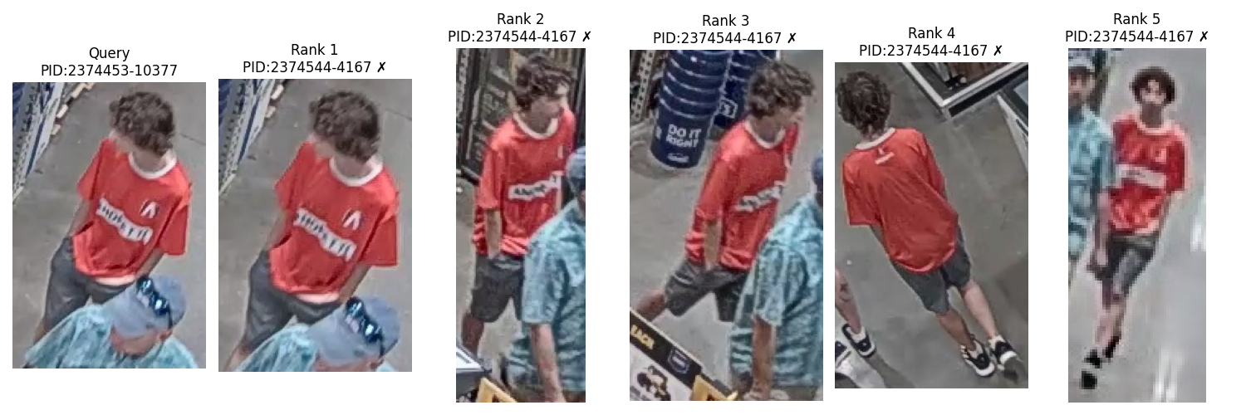
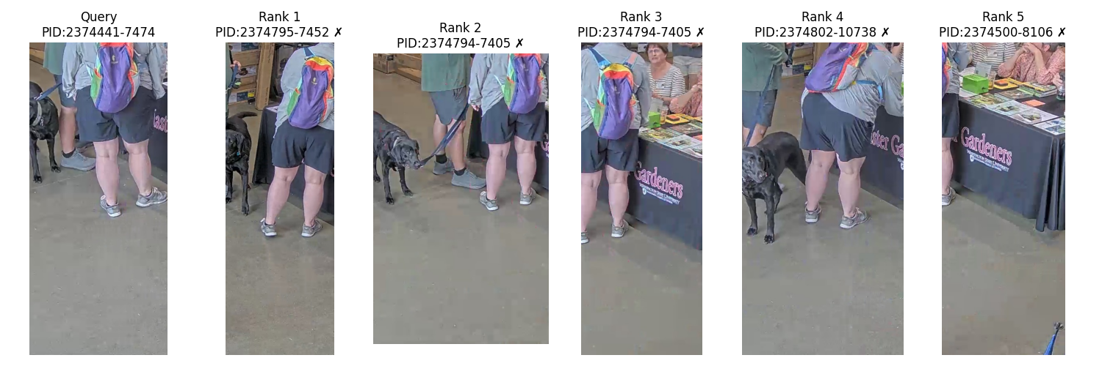
Label inconsistency in Gallery set
Distance threshold | IDs
0.07 | 127
0.08 | 175
0.09 | 240

Slide 25
Analysis of Trace-1573 Training Data
Filter out samples with person occlusions and low body points
Before filtering
Split | IDs | Images | Cameras
Train | 414 | 12720 | 45
Method | mAP | Top-1
CLIP-ReID | 63.3 | 80.8
After filtering
Min body keypoints | Images | MAP | Top-1
5 | 8328 | 62.7 | 80.1

Slide 26
Results using data augmentations
Aug Type | mAP | Top-1
Strong | 63.3 | 80.8
Weak | 52.2 | 75.8
Mask image
Mask image patches

Slide 27
ReID evaluation : Cosine vs Euclidean similarity
In the experiments , models are trained on Euclidean distance
Method | Distance | Train data | Test data | MAP(%) | Top-1 Accuracy(%)
CLIP-ReID | Euclidean | Market-1501 | Market-1501 | 89.8 | 95.3
CLIP-ReID | Cosine | Market-1501 | Market-1501 | 89.8 | 95.2
Method | Distance | Train data | Test data | MAP(%) | Top-1 Accuracy(%)
CLIP-ReID | Euclidean | Trace-ReID | Trace-ReID | 63.3 | 80.8
CLIP-ReID | Cosine | Trace-ReID | Trace-ReID | 63.2 | 80.5
At inference , The features are normalized before computing the distance matrix so, both metrics attribute towards similar performance

Slide 28
Experimental Results: Trace 1573 ReID Data
No of Samples per person ID per Camera | Method | MAP(%) | Top-1 Accuracy(%)
Train Set : 10 Gallery Set : 12 Query Set : 3 | OSNET | 34.2 | 68.4
 | CLIP-ReID | 63.3 | 80.8
Train Set : 30 Gallery Set : 12 Query Set : 3 | OSNET | 41.2 | 80.3
 | CLIP-ReID | 59.7 | 79.2
Train Set minimum samples : 5 Maximum samples 50 | OSNET | 39.2 | 77
 | CLIP-ReID | 59.9 | 82.5

Slide 29
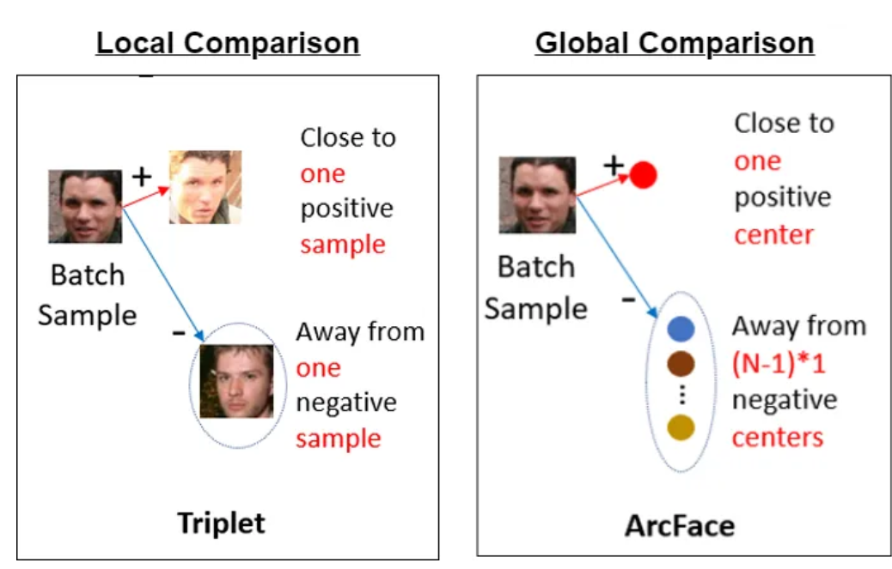
Arc Face vs Triplet Hard Mining Loss
Triplet Loss :
Optimizes the distance between positive and negative pairs .
Learns the embedding space
ArcFace Loss:
Classification-based loss that uses angular margin between class-centers
Works well in case of similar classes in training and testing.

Slide 30
Conclusion
Failure cases were mainly due to:
Poor person detections and missing body parts
Label inconsistencies, occlusions, and presence of multiple persons per frame
To address this, we applied a pose estimator to filter out low-quality samples
Improved sample quality (in both gallery and query sets) led to better overall performance
Replacing Cross-Entropy with ArcFace loss did not yield significant performance gains

Slide 31
Next steps
Implement CLIP-SCGI using existing synthetic generated captions in CLIP-ReID

